Slide 1
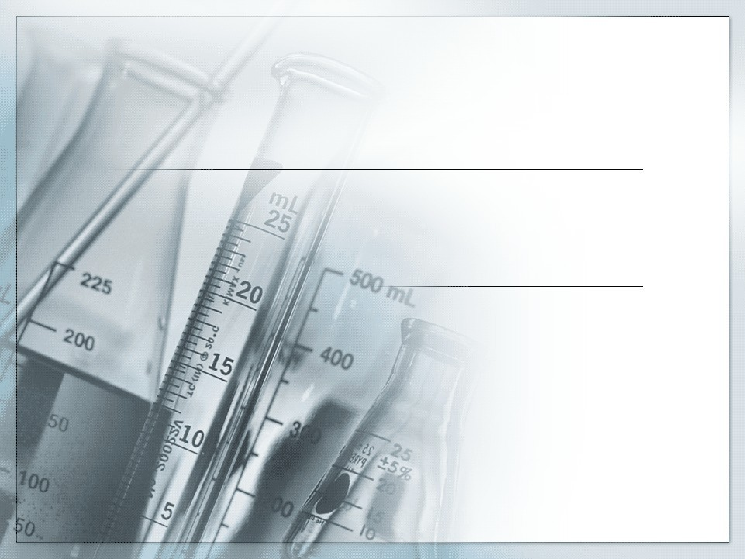

Barbiturates

Slide 2
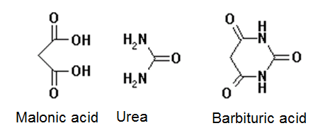
Barbiturates
•
Derivatives of Barbituric acid or Malonylurea: Combination of urea and malonic caid
Depressants of the central nervous system, impair or reduce activity of the brain by acting as a Gamma Amino Butyric Acid (GABA) potentiators
Produce alcohol like symptoms such as ataxia (impaired motor control), dizziness and slow breathing and heart rate
•
•

Slide 3

History
•
Barbituric acid was first preraed in 1864 by a German scientist - Adolf von Baeyer - by combining urea from animals and malonic acid from apples
Its first derivative utilized as a medicine was used to put dogs to sleep, latter Bayer produced Veronal in 1903 to be used as a sleeping aid
Soon after, phenobarbital and many other barbituric acid derivatives were discovered and marketed
•
•
•
•

Slide 4
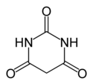

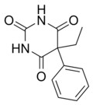
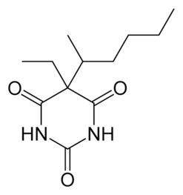
Types
Barbituric Acid
Amobarbital
Phenobarbital
Pentobarbital

Slide 5

Synthesis
Malonic Acid
Urea
Barbituric Acid
Barbituric acid is synthesized by a condensation reaction that results in the release of H₂O (dehydration) and the heterocyclic
pyrimidine
Further substitution of side chains on the ring produces the pharmacologically active barbiturates

Slide 6
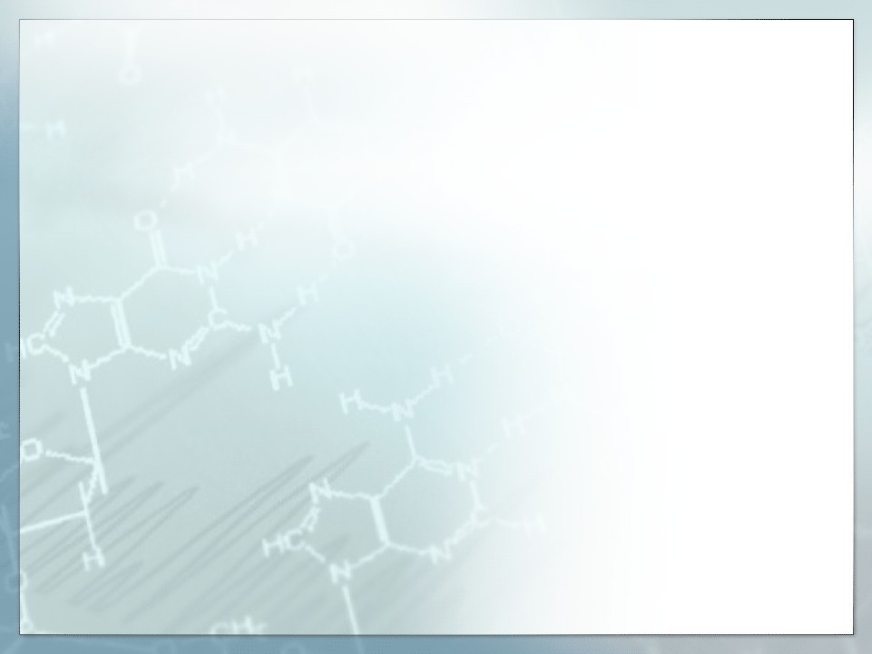
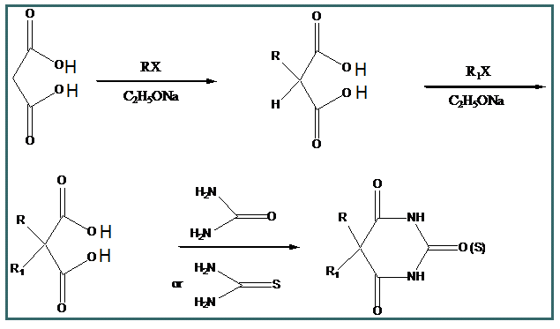
Synthesis

Slide 7
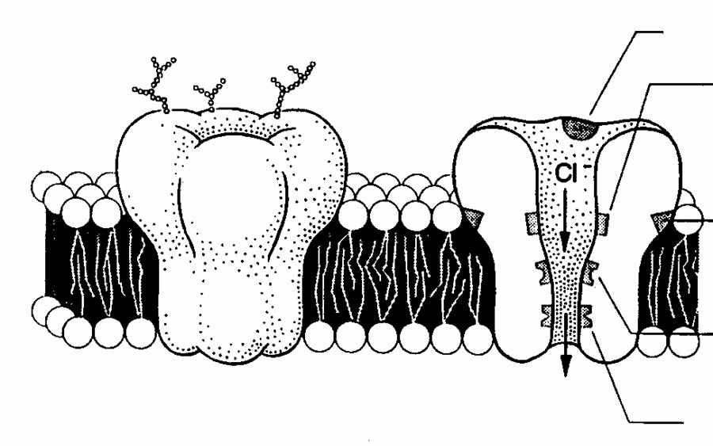

Mechanism of Action
Barbiturates potentiate the effect of GABA at the GABA-A receptor. The GABA-A receptor is a ligand gated ion channel membrane receptor that allows for the flow of Cl through the membrane in neurons. GABA is the principle neurotransmitter for this receptor which upon binding causes the channel to open and creates a negative charge in the transmembrane potential. This makes it an Inhibitory neurotransmitter
GABA binding site Barbiturate binding site
GABA

Slide 8
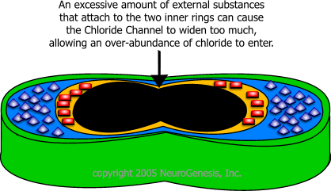
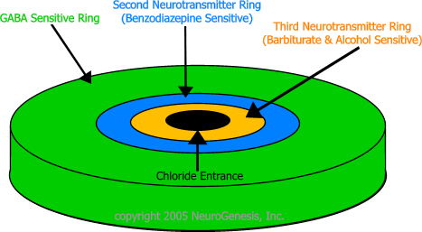
Mechanism of Action
Barbiturates potentiate the effect of GABA by binding to the GABA-A receptor at a nearby site and increasing the chloride flow through the channel. Barbiturates also block the AMPA (2-amino-3-(5-methyl-3-oxo- 1,2- oxazol-4-yl) propanoic acid) receptor which is sensitive to glutamate, the excitatory neurotransmitter. Glutamate performs the opposite effect from GABA restricting ion flow and increasing the transmembrane action potential of the neuron. By blocking this action Barbiturates serve to increase the duration of the receptor response to GABA and extend the depressed condition of the cell.

Slide 9
Uses
▪
Barbiturates have been use in the past to treat a variety of symptoms from insomnia and dementia to neonatal jaundice
They have largely been replaced with drugs such as benzodiazepine due to their propensity for addiction and reduced effect over the extended use
Still used widely to treat seizures particularily neonatal seizures
Used when benzo class drugs fail
Cannot be used for treatment of absence seizures
▪
▪
▪
▪

Slide 10
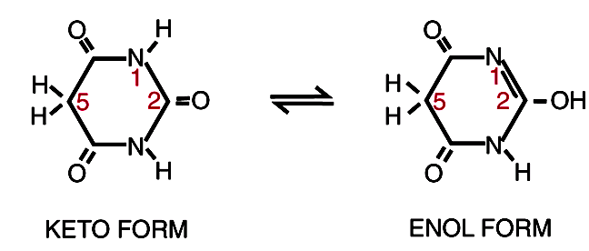
Structure activity relationship
▪
Modifying the structure of the hypnotically inactive barbituric acid can convert it into a hypnotic barbiturate with physicochemical properties that affect its ability to gain access to its sites of action and to interact with its receptor.
Hypnotic activity is introduced into the barbituric acid by the addition of side chains, especially if at least one of them is branched, in positions 5.
▪

Slide 11
▪
▪
Quaternary carbon at position 5 is necessary for activity
Unsubstituted compound is more acidic than di-substituted derivatives and do not depress CNS- unionized drug can penetrate the membrane
Introduction of one alkyl or aryl group at position 5 has little effect on acidity, whereas two groups decrease the acidity
When the sum of C-atoms at position 5 is larger than 7 or 8 activity drops for example dibenzyl barbituric acid produces no effect
Introduction of a polar functional group such as ether, keto, hydroxyl, amino and carboxyl, on the side chain usually destroys the depressant effect
▪
▪
▪

Slide 12
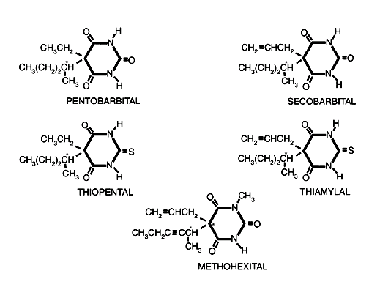
contnd
▪
The length of the side chains in the 5 position influences both the potency and the duration of action of the barbituric acid derivatives; secobarbital and thiamylal are slightly more potent than pentobarbital and thiopental, respectively, because the former drugs have slightly longer (three-carbon versus two-carbon) side chains in position 5

Slide 13
▪ Replacing the oxygen atom with a sulfur atom at position 2 of an active barbiturate produces a barbiturate with a more rapid onset and a shorter duration of action; the thiobarbiturates, thiopental and thiamylal, have faster onsets and shorter durations of action than their oxybarbiturate analogues, pentobarbital and secobarbital.

Slide 14
▪ Methylation of an active barbiturate in position 1 produces a drug such as methohexital with not only a rapid onset and short duration of action but also an increased incidence of excitatory side effects. Therefore, any chemical modification that increases the lipophilicity of a hypnotic barbiturate generally increases both its potency and its rate of onset while shortening its duration of action.

Slide 15
▪
Many barbiturates have asymmetric carbon atoms in one of the side chains attached to carbon 5 of the barbiturate ring. d isomers are two times potent, despite their similar access to the central nervous system.
Differences in the potency of stereoisomers suggests interaction with the chiral active center of a receptor rather than a nonspecific action
▪

Slide 16
Metabolism
▪
Metabolic transformation of barbiturates influence the duration and intensity of their action
Diethyl barbiturate is excreted unchanged in the urine
Most of the other barbiturates are metabolized in the liver before excretion
N-methyl barbiturates are demthylated in the liver
The terminal carbon of the side chain at position 5 is oxidized into carboxylic acids
▪
▪
▪
▪

Slide 17
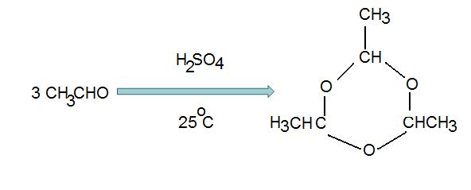
Aldehyde derivative-Paraldehyde
▪
Aliphatic aldehydes are thought to exert their hypnotic effect by being converted into corresponding alcohols
It is trimer of acetaldehyde and is considered to be cyclic acetal of the parent compound
It is a safe hypnotic and has prompt action
The main disadvantage is its pungent odour, taste and irritating effect on mucosa
▪
▪
▪

Slide 18
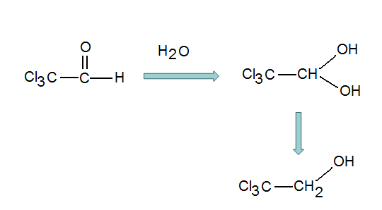
Chloral hydrate (trichloroacetaldehyde)
▪
▪
▪
A crystalline water soluble hydrate
Its active metabolite is trichloroethanol
It relieves insomnas without any after effects. However, it causes it causes gastric irritation, cardiac and respiratory depression
Trichloroethanol is excreted in urine as its glucuronide
▪

Slide 19
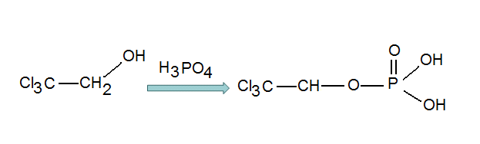
SAR
▪
Prolonged use of chloral hydrate leads to a condition similar to alcoholism or morphinism.
To lessen its side effects, some derivatives have been produced without side effects. For example trichloroethyl phosphate, which is a satisfactory and safe compound
▪

Slide 20

Chloral betaine
It is an aduct of betaine and carboxymethyl trimethyl ammonium
It is inert, tasteless and odorless compound
Action similar to chloral hydrate
(CH₃)₃ N⁺ CH₂
CO₂⁻

Slide 21
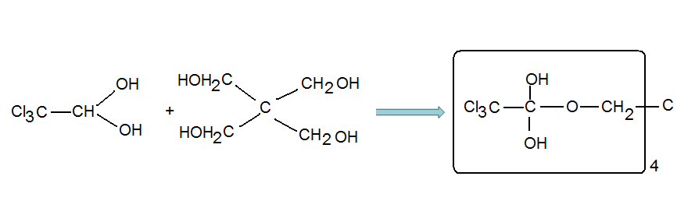
Petrichloral
It is a hemi-acetal fromed from chloral hydrate and penta erythrol
Has similar properties to chloral hydrate but free from after taste and GI irritation

Slide 22
Alcohols
▪ Ethyl alcohol
▪
Is narcotic and depresses, first the highest cerebral center and then the lower ones, cerebellum and spinal chord
Hypnotic activity increases with the increase in molecular weight, maximum with n-hexanol or n-octanol, afterwards activity declines
Branching in alkyl chain raises the activity, primary< secondary
<tertiary
Chlorination or bromination of simple and branched alcohol induces favorabl effect on distribution coefficient. For example trichloro or tribromoethanol has strong hypnotic activity
▪
▪
▪

Slide 23
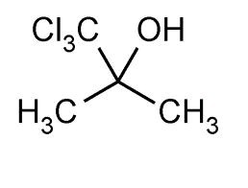
Chlorobutanol
2 hydroxy, 2 methyl, 1,1,1 trichloropropane (trichloro-2- methyl-2-propanol)
It is a strong hypnotic agent and has been used as preanesthetic medication
It is as dangerous as chloral hydrate

Slide 24
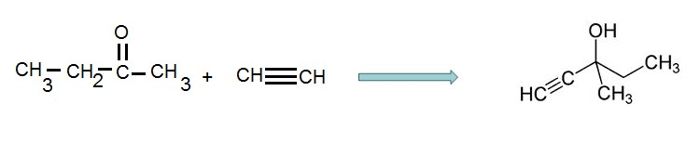
Methyl parafynol
Has pronounced hypnotic effect with wide margin of safety
Active orally and parenterally
Short duration of action due to oxidation of triple bond

Slide 25
Ethchlorvynol
▪
A sedative and hypnotic agent developed by Pfizer in the 1950. It was used to treat insomnia, but had largely been superseded
Still offered where an intolerance or allergy to other drugs exist
Along with expected sedative effects, ethchlorvynol can cause skin rashes, faintness, restlessness and euphoria.
An overdose is marked by confusion, fever, peripheral numbness and weakness, reduced coordination and muscle control, slurred speech, and reduced heartbeat.
▪
▪
▪

Slide 26

Synthesis
▪ By the reaction of lithium acetylide with 1-chloro-1- penten-3-one in liquid ammonia

Slide 27
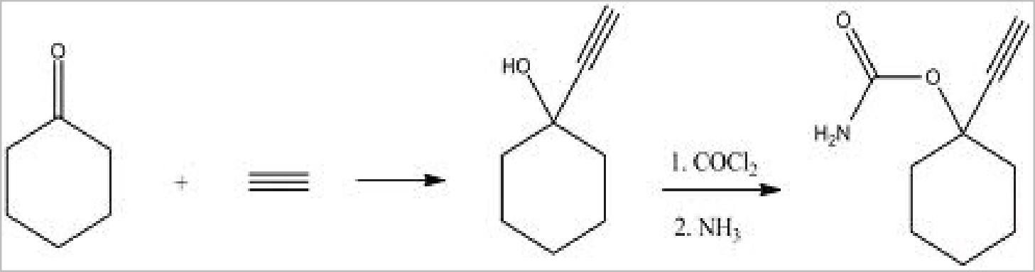
Ethinamate
▪
is a short-acting carbamate-derivative sedative-hypnotic medication used to treat insomnia. Regular use leads to drug tolerance, and it is usually not effective for more than 7 days. Prolonged use can lead to dependency.
Synthesized by combining acetylene with cyclohexanone and the transformation of the resulting carbinol into carbamate by the subsequent reaction with phosgene, and later with ammonia.
▪

Slide 28
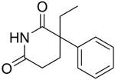

Glutarimide derivatives
▪
Glutarimide is a chemical compound featuring a piperidine ring with two ketones attached next to the nitrogen
Glutethimide
▪
Structurally similar to phenobarbital and produce hypnotic effect similar to barbiturates
Has short duration of action
Side effects include skin rash, nausea and addiction. Administered orally-500mg
▪
▪
▪

