Slide 1
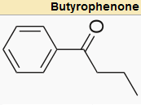
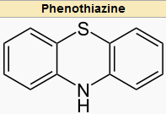
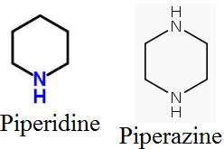
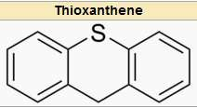
P
o t e n c y

Slide 2
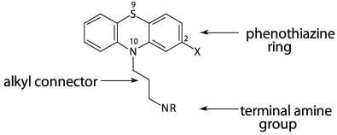
SAR of Phenothiazines

Slide 3
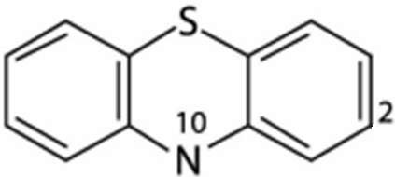
SAR of Phenothiazines
1) Unsubstituted Phenothiazines has no activity but has enough lipophilicity for good brain penetration.
Substitution at C2 and N10 is required for activtiy

Slide 4
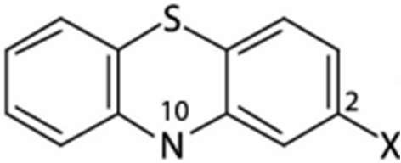
2) C2 must have an electrowithdrawing group. The activity for these various group is as
X = - SO2NR2 > -CF3 > -CO-CH3 > -Cl

Slide 5
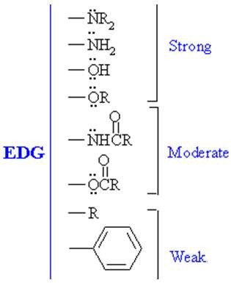
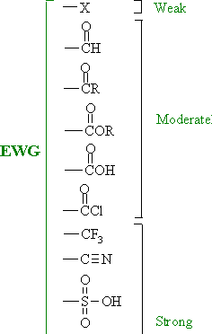
Electron Withdrawing
Electron Donating

Slide 6
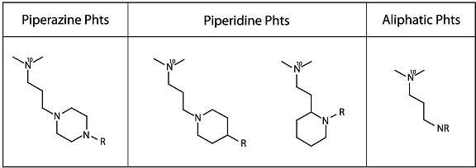
3) A terminal amino substituent must be present at N10. It can be piperazine, piperidine or aliphatic and their intensity could be ranked as follows: piperazine group
>piperidine group > aliphatic chain

Slide 7
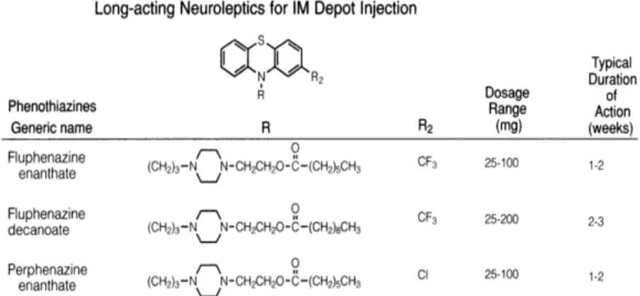
Esterification of the OH containing piperazine derivatives extensively increases the duration of action

Slide 8
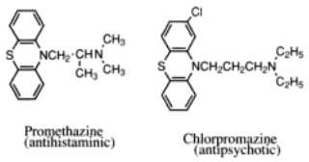
4) There must be an linear (ie unbranched) alkyl linker between the core ring and the terminal amino ring those length is optimum at three methylene units ie CH2-CH2-CH2
Reduction of these carbon number changes receptor affinity

Slide 9
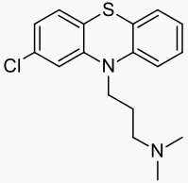
Chlorpromazine
It is a phenothiazine derivative used in treatment of schizophrenia. It was the first antiphycotic drug
It’s also used as antiemetic and against hippcup
Has high incidence of Extra Pyramidal side effects
It’s metabolite has strong antiadrenergic, weak anticholinergic and slight antihistaminergic and antiserotonergic properties (not parent molecule)
MOA: It antagonizes Dopamine D2 in the the Mesocortical and Mesolimbic pathway

Slide 10
Chlorpromazine synthesis
H
N Cl
CH₃
Cl CH₂ CH₂ CH₂ N
CH₃
3-Chloropropyl-dimethylamine
S
2-Chlorophenothiazine
Refulx
in presence of toulene and sodamide
CH₃
CH₂ CH₂ CH₂ N
CH₃
N
Cl
Chloropromazine
S

Slide 11
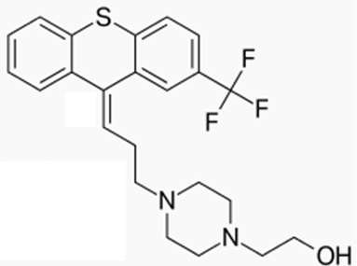
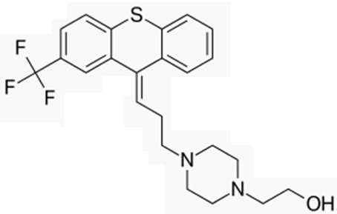
R₁
R₂
R₁
R₂
Trans has R groups on opposite side of double bond
Cis has R groups on same side of double bond
Decide cis and trans in these compounds?

Slide 12
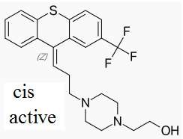
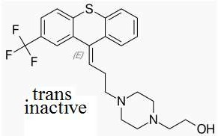
Flupenthixol
It is a Thioxanthine derivative used for treatment of schizophrenia
It can exist in cis and trans form and only cis is active because it mimics the conformation of Dopamine
It’s duration of action is long (2-3 weeks) and hence useful in patients who have a poor compliance with medication
MOA- It is nonselective and antagonizes both Dopamine D1 and D2 in the the Mesocortical and Mesolimbic pathway

Slide 13
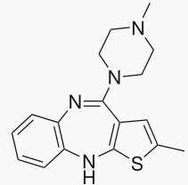
Olanzapine
It is an atypical drug used for treatment of
of schizophrenia and also used in bipolar disorder
Olanzapine is a potent antagonist of the muscarinic M₃ receptor and this has been linked to it’s diabetic side effect
It can cause heart failure, sudden death, or pneumonia when used in older adults suffering from dementia
MOA: It has low antagonist activity in Dopamine D2 receptor and primary action is believed to have occurred through inverse agonism at Serotonin 5HT_{2A} and antagonism at adrenergic receptors

Slide 14
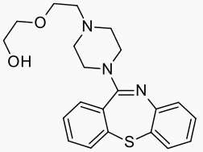
Quetiapine
It is a short-acting atypical antipsychotic used for the treatment of schizophrenia and bipolar disorder
It is a dopamine, serotonin, and adrenergic antagonist, and a potent antihistamine with negligible anticholinergic properties.
MOA: It has low antagonist activity in Dopamine D2 receptor and primary action is believed to have occurred through antagonism at both Serotonin 5HT_{2A} and adrenergic receptors

