Slide 1
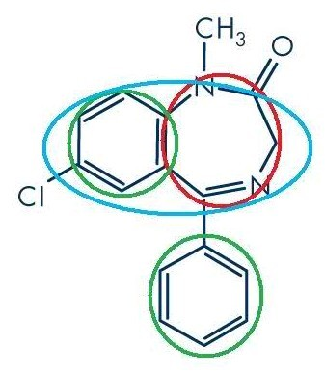
Benzodiazepines
All benzodiazepines have a benzene ring attached to a diazepine ring.
In the green circles are benzene rings and in the red circle is a diazepine ring, with the whole 1,4-benzodiazepine system being in the blue ring (the 1 and 4 denote the position of the nitrogen atoms in the ring

Slide 2
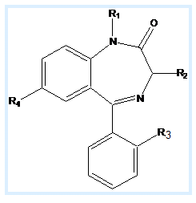
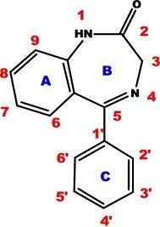
Benzodiazepines
Different benzodiazepines have been developed through chemical substitutions at two major positions on the benzodiazepine structure
Therefore, all benzodiazpines are simply variations on the same core chemical structure.

Slide 3
Benzodiazepine
 | R1 | R2 | R3 | R4
a | CH3 | H | H | Cl
b | CH3 | H | F | Cl
c | H | H | H | NO2
d | H | H | Cl | NO2
a. diazepam
d. clonazepam
b.flutoprazepam
c. nitrazepam

Slide 4
Modification: (triazole or imidazole) estazolam, alprazolam, trizolam and
midazolam
R₁
N
N
R1 H
R2
H
N
estazolam
Cl
N
(Z)
alprazolam
CH₃
H
R₂
trizolam
CH₃
Cl
H₃C
N
Midazolam
CH₃
F
N
Cl
N
(E)
F

Slide 5
The duration of action for an individual benzodiazepine depends on two factors:
the half-life and
the metabolic fate

Slide 6
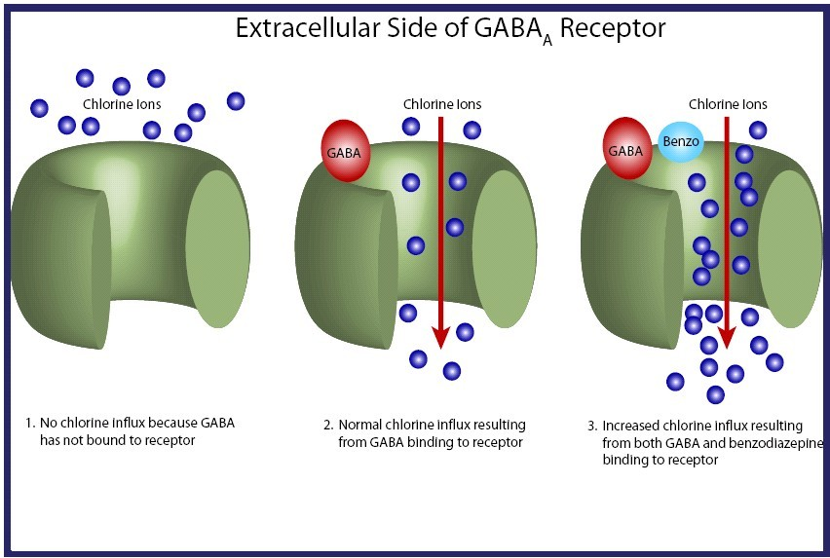
Mechanism of action

Slide 7
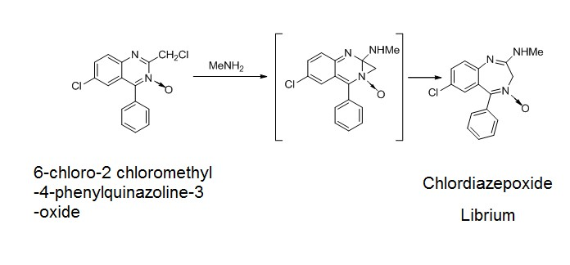
Chemical synthesis of Librium

Slide 8
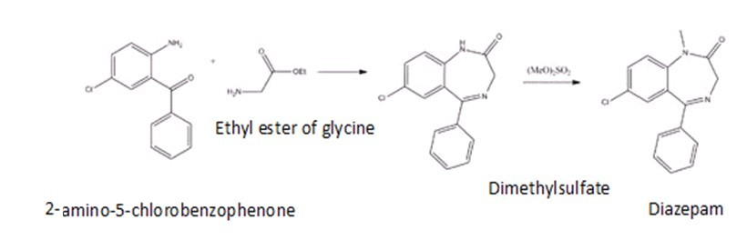
Chemical synthesis of diazepam

Slide 9
Structure- activity relationship:
The electron attractive substituents on ring A enforce the activity
NO2>Br>CF3>Cl
Ring B is necessary for activity
The electron attractive substituents with small volume on benzene ring of C-5 will enforce the activity
The hydrolysis of amide and imine

Slide 10
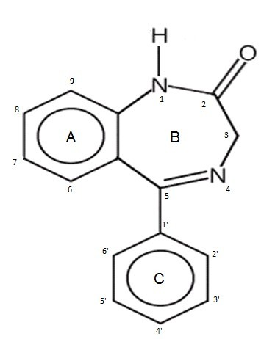
Ring A
The minimum requirement for 5-phenyl 1,4 benzodiaipin 2one derivatives to BZR include an aromatic or hetroaromatic ring
It is believed to participate in pi-pi bonding with aromatic residue of aromatic amino acids of the receptor
The substitution on this ring produces varied effect on binding with the receptor, however such effects are not predictable on the basis of electronic and stearic properties

Slide 11
An electronegative group (halo or nitro) substituted at 7-position markedly increase activity and binding affinity
Substitution on 6,8 and 9 decrease the activity
On the other hand 1-4 diazepine derivative having ring A replaced with hetrocyclic ring have weak activity and affinity as compared to phenyl derivatives

Slide 12
Ring B
A proton accepting group (carbonyl oxygen) at 2- position of ring B is necessary to interact with receptor histidine residue that act as proton donor and help in ligand binding
Electron donating group must be in the same plane with electronegative group on ring A, favoring a coplanar spatial orientation of two moieties Substitution of O with S effect selective binding GABA BZR sub-populations but anxiolytic activity is maintained
Substitution 3-position methylene or imine nitrogen is sterically unfavorable
Derivatives having 3-hydroxy moiety have comparable potency to non-hydroxylated analogue but are excreted faster

Slide 13
Esterification of 3-hydroxy moiety is possible without loss of activity
1-poition amide nitrogen and its substituent are not required for in vitro binding with BZR because many N-alkyl side chains don’t decrease BZR affinity Neither 4,5 double bond nor the nitrogen of 4-position is required for activity
If C=N is reduced BZR affinity is decreased but the derivatives again oxidized in the body to C=N

Slide 14
Ring C
The 5-phenyl ring C is not required for binding to the BZR in vitro, however, this aromatic ring contribute favorable hydrphobic or steric interactions to receptor binding and its relationship to ring A
Substitution at 4' (para position) is unfavorable for activity, however, ortho substitution is not detrimental to agonist activity

Slide 15
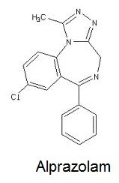
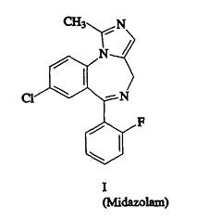
Annelating the 1,2 bond of ring B with an additional electron rich ring such as triazole (alprazolam) or imidazole (midazolam) results in pharmacologically active benzodiazepine derivatives with high affinity to BZR
triazole
imidazole

Slide 16
